Slide 1
Social Analytics Project A Graph Based Recommender System (Jiak*Bot 2.0)
*jiak - literal translation of the Hokkien verb “Eat”
Chris Thng | Ong Han Ying | Tham Jun Quan | Wesley Chan Lun
Yang Cheng | Ye Zhibo

Slide 2
Objective
Inspired from a common problem working class adults face Singapore - where and what to eat for lunch
Aims to suggest places to eat through a chatbot through social graph mining and more specifically,
Detecting Community and
Providing Graph Based Recommendations

Slide 3
Methodology
Phase 1: Data Preparation
Phase 2: Analysis via Social Analytics
Phase 3: Application
Foursquare
Clustering
Web Visualization
Spectral Clustering /w Unipartite Projection
Community Detection
API
Gaussian Mixed Model
K-Means
Restaurant Recommendation
Tips
(n=64381)
Venues
(n=5540)
SQLite
Users
(n=24289)
Friends
(n=148001)
Application
Recommendations
Jiakbot
New Users
Existing Users
JSON

Slide 4

Detecting Communities
Clustering based on User Relationship Projected from Sentiment Scores
Identify users with similar sentiment score for a given venue
Identify users with similar taste by venue type
Clustering based on Venue Type
Recommender System
Identify users going to similar geographical location for food
Clustering based on Venue Location

Slide 5



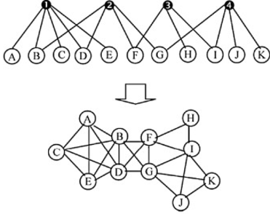
Clustering Based on User Relationship
Sentiment Score
Bipartite Graph
Nodes: Users and Venues
Edges: Computed sentiment score derived from tips
Similar sentiment score for same venue
6 Clusters
Construct Bipartite Graph
Perform Spectral Clustering
Unipartite Projection
Determine Optimal K
user
venue
user - user
Train models and determine optimal K, using AIC/BIC

Slide 6


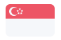



Clustering Based on Venue Type
Group venues into:
Chinese Restaurants
Indian Restaurants etc.
9 Clusters
Grouping Venues Types
Perform K Means Clustering
Count Visits
Determine Optimal K
 | Chinese Restaurant | Indian Restaurant | Japanese Restaurant | … | Malay Restaurant
User 1 | 3 | 0 | 1 | … | 0
User 2 | 0 | 4 | 0 | … | 1
… | … | … | … | … | …
User n | 1 | 0 | 3 |  | 2
Train models and determine optimal K, using AIC/BIC

Slide 7
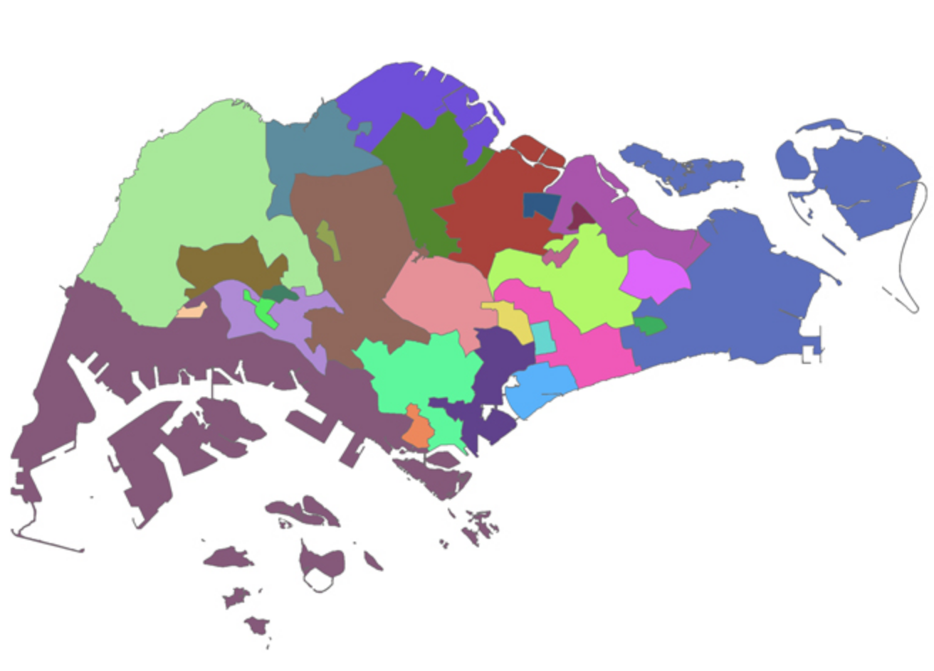
Clustering Based on Venue Location
Group venues based on their locations into 20 regions
Central, North etc.
20 Clusters
Grouping Venue Locations
Count Visits by Proportion
Perform K Means Clustering
Determine Optimal K
 | Central (CBD) | Central (C1) | North East (NE1) | … | West (W1)
User 1 | 0.5 | 0 | 0 | … | 0.5
User 2 | 0.2 | 0.3 | 0.3 | … | 0.2
… | … | … | … | … | …
User n | 0 | 0 | 0.5 | … | 0.5
Train models and determine optimal K, using AIC/BIC

Slide 8
How did we recommend?
A user is classified by:
the type of restaurants they go to
the location of the restaurants they go to
the user-user similarity based on sentiment scores
Recommendations based on clusters identified earlier
Within each cluster, for each user,
Identify users who visited the same restaurants
Get the list of restaurants visited by these users
Rank the restaurants by weighting sentiment and frequency of visits
Return the top n restaurants by rank

Slide 9
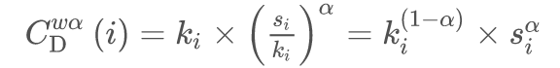
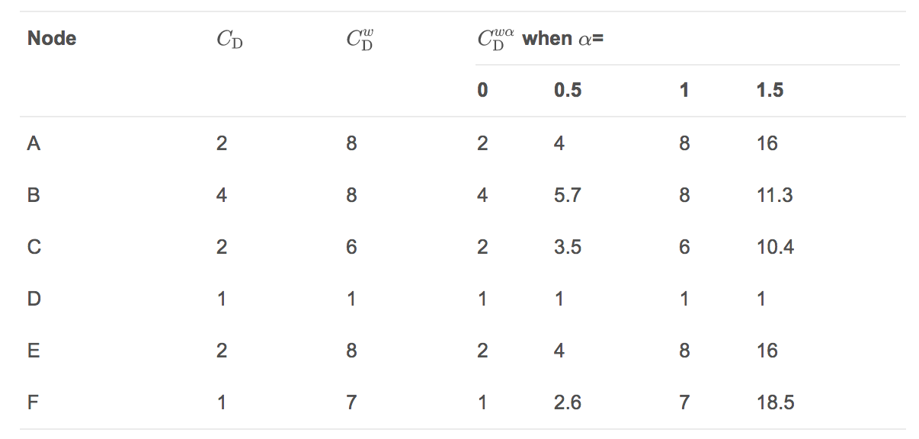
How did we rank?
Using a method proposed by Opsahl et al. (2010)
A generalization for edge weights (sentiment score) and number of edges (frequency of visit).

Slide 10
In layman terms, we consider both sentiment and number of visits in ranking the venues

Slide 11
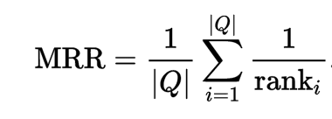
Evaluating the Recommendations
Evaluation is done by using the Mean Reciprocal Rank (MRR)

Slide 12
In layman terms, it meant that on average, what is the rank position of the a relevant restaurant.

Slide 13



Evaluation Results
Mean Reciprocal Rank
0.0369
Relevant recommendation ranked around #28
Recent History
+
0.0519
Relevant recommendation ranked around #20
Full History
Venue
+
+
+
0.0672
Relevant recommendation ranked around #15
Full History
Venue
Rating
Location

Slide 14
Using the Results
Web Visualisation
Jiakbot 2.0 (@jiak_bot)

Slide 15

How JiakBot 2.0 Works
Data
Scrape businesses data from FourSquare including their reviews.
Using Graph Mining Techniques to make Recommendations
Where can I get chicken rice?
Jiakbot 2.0
User – Venue Graph
Information
extraction
Parsing incl. Stmt / Question Classification
Generate Response
Display Answer
Boon Tong Kee is Nice!
Retrieve Recommendations based on
Food or Cuisine user entered
User’s Clusters

Slide 16
Q + A

